Slide 1
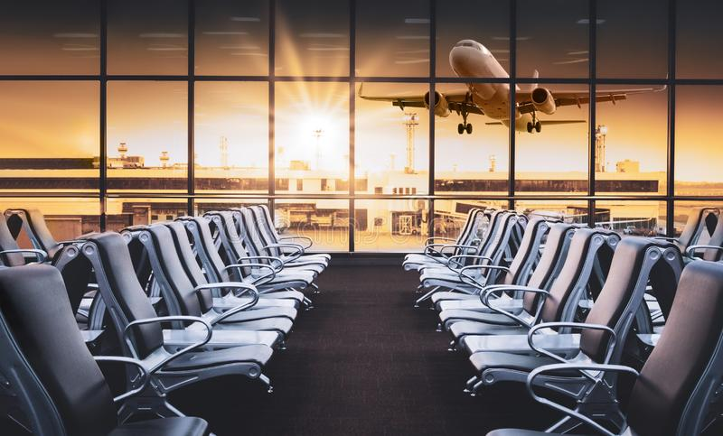
MGT 506- Presentation
By Divya Bhattiprolu
Course Name: Decision Making for Managers

Slide 2
Case Study: Forecasting Airport Passenger Arrivals
In the process of ensuring airline security, airports have faced the problem of long waiting lines and waiting times at security gates.
In their efforts to reduce waiting lines and times, or at least to not have them become longer as airline demand increases, airports have analyzed their existing security systems and sought quantitative solutions.
Berry International Airport (BEI), is facing issues with the staffing and security check points.
There are two main concourses at BEI, North and South, each serving different airlines.

Slide 3
Objective
BEI is having problems with the long waiting lines and times specially in the airport’s busiest travel moth of the year July.
The arrival of passengers has increased in the past 3 years. This data has been tracked .
Forecast the airport passenger arrival for the 4th year at the South concourse at BEI.

Slide 4
Parameters
Passenger arrival at South concourse in 2-hour segments from 4:00 AM to 10:00 PM.
10 days (selected randomly) for past 3 years.
For the busiest travel month of the year, July.

Slide 5
Data Table
 | DAY | 4-6 AM | 6-8 AM | 8-10 AM | 10-12 PM | 12-2 PM | 2-4 PM | 4-6 PM | 6-8 PM | 8-10 PM
Year 1 | 1 | 2400 | 2700 | 3200 | 1400 | 1700 | 1800 | 1600 | 800 | 200
 | 2 | 1900 | 2500 | 3100 | 1600 | 1800 | 2000 | 1800 | 900 | 300
 | 3 | 2300 | 3100 | 2500 | 1500 | 1500 | 1800 | 1900 | 1100 | 200
 | 4 | 2200 | 3200 | 3100 | 2200 | 1900 | 2400 | 2100 | 1200 | 400
 | 5 | 2400 | 3300 | 3400 | 1700 | 2200 | 2100 | 2000 | 1000 | 600
 | 6 | 2600 | 2800 | 3500 | 1500 | 1700 | 1900 | 1500 | 1100 | 300
 | 7 | 1900 | 2800 | 3100 | 1200 | 1500 | 2000 | 1400 | 900 | 400
 | 8 | 2000 | 2700 | 2500 | 1500 | 2000 | 2300 | 1900 | 1000 | 200
 | 9 | 2400 | 3200 | 3600 | 1600 | 2100 | 2500 | 1800 | 1400 | 200
 | 10 | 2600 | 3300 | 3100 | 200 | 2500 | 2600 | 2400 | 1100 | 400
Year 2 | 11 | 3100 | 3900 | 4100 | 2200 | 2600 | 2300 | 2500 | 1100 | 300
 | 12 | 2800 | 3400 | 3900 | 1900 | 2100 | 2500 | 2000 | 1200 | 300
 | 13 | 2700 | 3800 | 4300 | 2100 | 2400 | 2400 | 2400 | 1200 | 400
 | 14 | 2400 | 3500 | 4100 | 2400 | 3000 | 3200 | 2600 | 1200 | 700
 | 15 | 3300 | 3700 | 4000 | 2600 | 2600 | 2700 | 2900 | 1000 | 300
Passenger Arrival data

Slide 6
Data Table
 | DAY | 4-6 AM | 6-8 AM | 8-10 AM | 10-12 PM | 12-2 PM | 2-4 PM | 4-6 PM | 6-8 PM | 8-10 PM
Year 2 | 16 | 3500 | 4000 | 3800 | 2300 | 2700 | 3100 | 3000 | 900 | 200
 | 17 | 2900 | 4100 | 3900 | 2400 | 3000 | 3200 | 2500 | 1100 | 500
 | 18 | 3400 | 3800 | 4200 | 2000 | 2500 | 3000 | 2200 | 1000 | 300
 | 19 | 3600 | 3600 | 4000 | 2300 | 2600 | 2800 | 2600 | 1200 | 200
 | 20 | 3700 | 3700 | 4000 | 2200 | 2600 | 2700 | 2400 | 1200 | 200
Year 3 | 21 | 4400 | 4400 | 4500 | 2600 | 3300 | 3400 | 3000 | 1200 | 400
 | 22 | 4200 | 4500 | 4300 | 2500 | 3400 | 3600 | 3100 | 1400 | 300
 | 23 | 4500 | 4500 | 4700 | 2700 | 3400 | 3500 | 2900 | 1200 | 300
 | 24 | 4600 | 4600 | 4600 | 2500 | 3200 | 3500 | 2800 | 1300 | 300
 | 25 | 4500 | 4300 | 4400 | 2900 | 3300 | 3300 | 3300 | 1500 | 400
 | 26 | 4200 | 4300 | 4500 | 3000 | 4000 | 3400 | 3000 | 1500 | 600
 | 27 | 4500 | 4500 | 5100 | 3300 | 4000 | 3700 | 3100 | 1200 | 300
 | 28 | 4300 | 4200 | 4300 | 2800 | 3500 | 4000 | 3300 | 1100 | 400
 | 29 | 4900 | 4100 | 4200 | 3100 | 3600 | 3900 | 3400 | 1400 | 500
 | 30 | 4700 | 4500 | 4100 | 3000 | 4000 | 3700 | 3400 | 1200 | 500
Passenger Arrival data

Slide 7
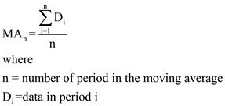
Analysis
The forecast for the next year July can be calculated using the Time Series Analysis method.
This can be done through the Moving Average method of forecasting.
Moving average uses values from the recent past to develop forecasts.
The formula for Moving Average (MA):

Slide 8
Time Series Method
DAY | 4-6 AM | 6-8 AM | 8-10 AM | 10-12 PM | 12-2 PM | 2-4 PM | 4-6 PM | 6-8 PM | 8-10 PM
1 | 2200 | 2767 | 2933 | 1500 | 1667 | 1867 | 1767 | 933 | 233
2 | 2133 | 2933 | 2900 | 1767 | 1733 | 2067 | 1933 | 1067 | 300
3 | 2300 | 3200 | 3000 | 1800 | 1867 | 2100 | 2000 | 1100 | 400
4 | 2400 | 3100 | 3333 | 1800 | 1933 | 2133 | 1867 | 1100 | 433
5 | 2300 | 2967 | 3333 | 1467 | 1800 | 2000 | 1633 | 1000 | 433
6 | 2167 | 2767 | 3033 | 1400 | 1733 | 2067 | 1600 | 1000 | 300
7 | 2100 | 2900 | 3067 | 1433 | 1867 | 2267 | 1700 | 1100 | 267
8 | 2333 | 3067 | 3067 | 1100 | 2200 | 2467 | 2033 | 1167 | 267
9 | 2700 | 3467 | 3600 | 1333 | 2400 | 2467 | 2233 | 1200 | 300
10 | 2833 | 3533 | 3700 | 1433 | 2400 | 2467 | 2300 | 1133 | 333
11 | 2867 | 3700 | 4100 | 2067 | 2367 | 2400 | 2300 | 1167 | 333
12 | 2633 | 3567 | 4100 | 2133 | 2500 | 2700 | 2333 | 1200 | 467
13 | 2800 | 3667 | 4133 | 2367 | 2667 | 2767 | 2633 | 1133 | 467
14 | 3067 | 3733 | 3967 | 2433 | 2767 | 3000 | 2833 | 1033 | 400
15 | 3233 | 3933 | 3900 | 2433 | 2767 | 3000 | 2800 | 1000 | 333
The following is the table of the passengers for the month of July calculated through moving average method using Excel.

Slide 9
Continued..
DAY | 4-6 AM | 6-8 AM | 8-10 AM | 10-12 PM | 12-2 PM | 2-4 PM | 4-6 PM | 6-8 PM | 8-10 PM
16 | 3267 | 3967 | 3967 | 2233 | 2733 | 3100 | 2567 | 1000 | 333
17 | 3300 | 3833 | 4033 | 2233 | 2700 | 3000 | 2433 | 1100 | 333
18 | 3567 | 3700 | 4067 | 2167 | 2567 | 2833 | 2400 | 1133 | 233
19 | 3900 | 3900 | 4167 | 2367 | 2833 | 2967 | 2667 | 1200 | 267
20 | 4100 | 4200 | 4267 | 2433 | 3100 | 3233 | 2833 | 1267 | 300
21 | 4367 | 4467 | 4500 | 2600 | 3367 | 3500 | 3000 | 1267 | 333
22 | 4433 | 4533 | 4533 | 2567 | 3333 | 3533 | 2933 | 1300 | 300
23 | 4533 | 4467 | 4567 | 2700 | 3300 | 3433 | 3000 | 1333 | 333
24 | 4433 | 4400 | 4500 | 2800 | 3500 | 3400 | 3033 | 1433 | 433
25 | 4400 | 4367 | 4667 | 3067 | 3767 | 3467 | 3133 | 1400 | 433
26 | 4333 | 4333 | 4633 | 3033 | 3833 | 3700 | 3133 | 1267 | 433
27 | 4567 | 4267 | 4533 | 3067 | 3700 | 3867 | 3267 | 1233 | 400
28 | 4633 | 4267 | 4200 | 2967 | 3700 | 3867 | 3367 | 1233 | 467
29 | 4800 | 4300 | 4150 | 3050 | 3800 | 3800 | 3400 | 1300 | 500
30 | 4700 | 4500 | 4100 | 3000 | 4000 | 3700 | 3400 | 1200 | 500
The following is the table of the passengers for the month of July calculated through moving average method using Excel.

Slide 10
Forecast Conclusion
From the table in the previous slides, it is observed that the arrival of the passengers at the South concourse, is more between 4:00 AM to 10:00 AM.
Therefore, more number of checkpoints are necessary during this time.

Slide 11
Thank You

